Slide 1
Unit - V
Introduction - AWT & Swings

Slide 2
AWT and Swing are used to develop window-based applications in Java.
Awt is an abstract window toolkit that provides various component classes like Label, Button, TextField, etc., to show window components on the screen.
All these classes are part of the Java.awt package.
Swing is the part of JFC (Java Foundation Classes) built on the top of AWT and written entirely in Java. The javax.swing API provides all the component classes like JButton, JTextField, JCheckbox, JMenu, etc.

Slide 3
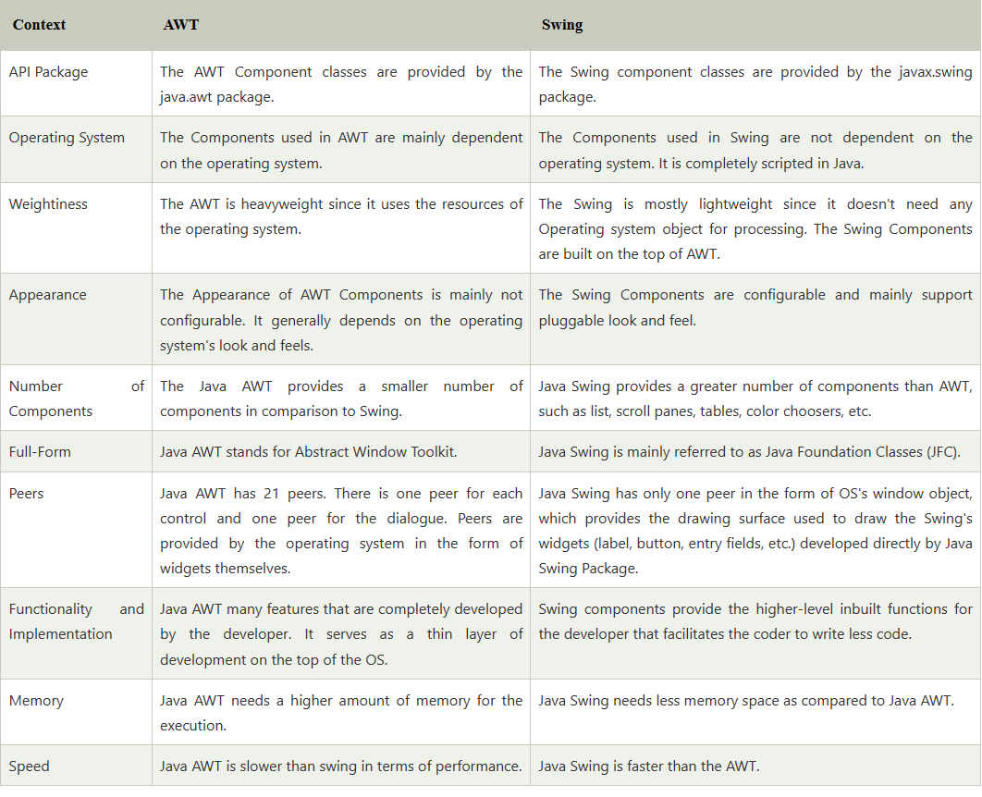

Slide 4
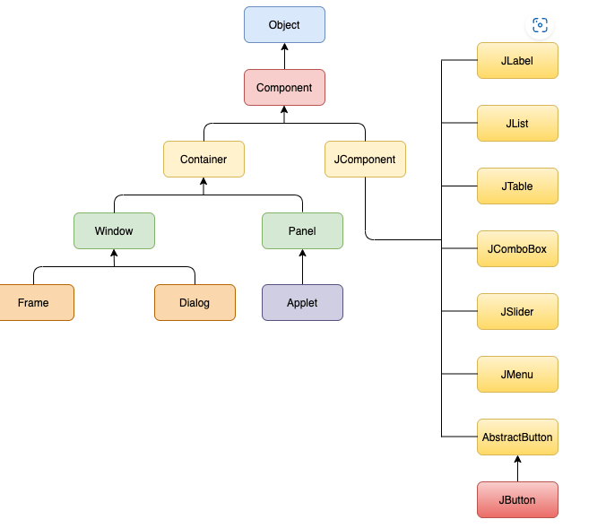
Swing hierarchy

Slide 5
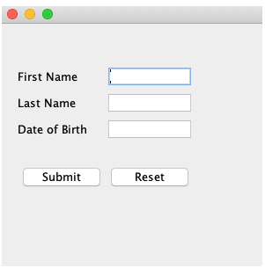
import javax.swing.*;
public class SwingApp {
SwingApp(){
JFrame f = new JFrame();
JLabel firstName = new JLabel("First Name");
firstName.setBounds(20, 50, 80, 20);
JLabel lastName = new JLabel("Last Name");
lastName.setBounds(20, 80, 80, 20);
JLabel dob = new JLabel("Date of Birth");
dob.setBounds(20, 110, 80, 20);
JTextField firstNameTF = new JTextField();
firstNameTF.setBounds(120, 50, 100, 20);
JTextField lastNameTF = new JTextField();
lastNameTF.setBounds(120, 80, 100, 20);
JTextField dobTF = new JTextField();
dobTF.setBounds(120, 110, 100, 20);
JButton sbmt = new JButton("Submit");
sbmt.setBounds(20, 160, 100, 30);
JButton reset = new JButton("Reset");
reset.setBounds(120,160,100,30);
f.add(firstName);
f.add(lastName);
f.add(dob);
f.add(firstNameTF);
f.add(lastNameTF);
f.add(dobTF);
f.add(sbmt);
f.add(reset);
f.setSize(300,300);
f.setLayout(null);
f.setVisible(true); }
public static void main(String[] args) {
// TODO Auto-generated method stub
SwingApp s = new SwingApp(); }}

Slide 6
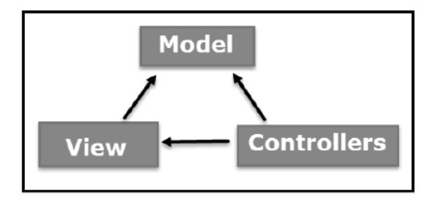
MVC architecture, components, containers
The Model-View-Controller (MVC) is an architectural pattern that separates an application into three main logical components:
The model,
the view, and
the controller.
Each of these components are built to handle specific development aspects of an application
The model designs based on the MVC architecture follow MVC design pattern. The application logic is separated from the user interface while designing the software using model designs.

Slide 7
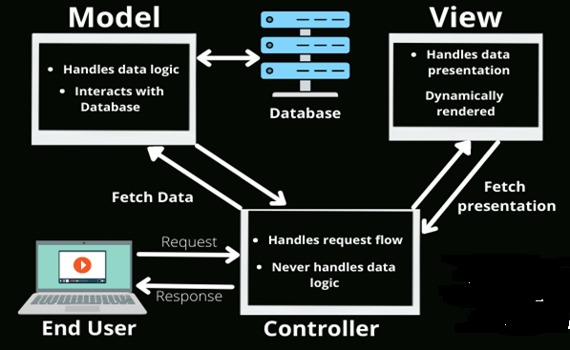
The MVC pattern architecture consists of three layers:
Model: It represents the business layer of application. It is an object to carry the data that can also contain the logic to update controller if data is changed.
View: It represents the presentation layer of application. It is used to visualize the data that the model contains.
Controller: It works on both the model and view. It is used to manage the flow of application, i.e. data flow in the model object and to update the view whenever data is changed.

Slide 8
Advantages of MVC Architecture
The advantages of MVC architecture are as follows:
MVC has the feature of scalability that in turn helps the growth of application.
The components are easy to maintain because there is less dependency.
A model can be reused by multiple views that provides reusability of code.
The developers can work with the three layers (Model, View, and Controller) simultaneously.
Using MVC, the application becomes more understandable.
Using MVC, each layer is maintained separately therefore we do not require to deal with massive code.
The extending and testing of application is easier.
To implement MVC pattern in Java, we are required to create the following three classes.
Employee Class, will act as model layer
EmployeeView Class, will act as a view layer
EmployeeContoller Class, will act a controller layer

Slide 9
Model class
public String getName() {
return EmployeeName;
}
public void setName(String name) {
this.EmployeeName = name;
}
public String getDepartment() {
return EmployeeDepartment;
}
public void setDepartment(String Department) {
this.EmployeeDepartment = Department;
}
}
public class Employee {
// declaring the variables
private String EmployeeName;
private String EmployeeId;
private String EmployeeDepartment;
// defining getter and setter methods
public String getId() {
return EmployeeId;
}
public void setId(String id) {
this.EmployeeId = id;
}

Slide 10
public class EmployeeView {
// method to display the Employee details
public void printEmployeeDetails (String EmployeeName, String EmployeeId, String EmployeeDepartment){
System.out.println("Employee Details: ");
System.out.println("Name: " + EmployeeName);
System.out.println("Employee ID: " + EmployeeId);
System.out.println("Employee Department: " + EmployeeDepartment);
}
}

Slide 11
public class EmployeeController {
// declaring the variables model and view
private Employee model;
private EmployeeView view;
// constructor to initialize
public EmployeeController(Employee model, EmployeeView view) {
this.model = model;
this.view = view;
}
// getter and setter methods
public void setEmployeeName(String name){
model.setName(name);
}
public String getEmployeeName(){
return model.getName();
}
public void setEmployeeId(String id){
model.setId(id);
}
public String getEmployeeId(){
return model.getId();
}
public void setEmployeeDepartment(String Department){
model.setDepartment(Department);
}
public String getEmployeeDepartment(){
return model.getDepartment();
}
// method to update view
public void updateView() {
view.printEmployeeDetails(model.getName(), model.getId(), model.getDepartment());
}
}

Slide 12
public class MVCMain {
public static void main(String[] args) {
// fetching the employee record based on the employee_id from the database
Employee model = retriveEmployeeFromDatabase();
// creating a view to write Employee details on console
EmployeeView view = new EmployeeView();
EmployeeController controller = new EmployeeController(model, view);
controller.updateView();
//updating the model data
controller.setEmployeeName("Nirnay");
System.out.println("\n Employee Details after updating: ");
controller.updateView();
}
private static Employee retriveEmployeeFromDatabase(){
Employee Employee = new Employee();
Employee.setName("Anu");
Employee.setId("11");
Employee.setDepartment("Salesforce");
return Employee;
}
}

Slide 13
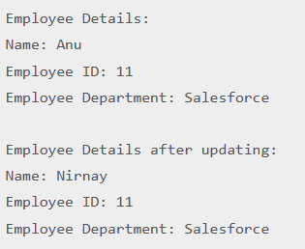
Oputput:

Slide 14
Container
A container is a kind of component that holds and manages components.
JComponent objects can be containers, because the JComponent class descends from the Container class.
Three of the most useful container types are
JFrame : is a top-level window on your display. Is dirived from JWindow, which is pretty much the same but lacks a border
Jpanel: Is a generic container element used to group components inside of JFrames and other JPanels.
JApplet : A class is a kind of container that provides the foundation for applets that run inside web browsers.
The add( ) method of the Container class adds a component to the container.
Remove a component from a container with the remove( ) method.

Slide 15
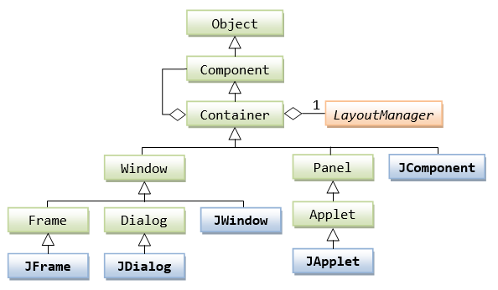

Slide 16
Layout Managers
he Layout managers enable us to control the way in which visual components are arranged in the GUI forms by determining the size and position of components within the containers.
LayoutManager is an interface that is implemented by all the classes of layout managers. There are the following classes that represent the layout managers:
Types of LayoutManager
java.awt.BorderLayout
java.awt.FlowLayout
java.awt.GridLayout
java.awt.CardLayout
java.awt.GridBagLayout
javax.swing.BoxLayout
javax.swing.GroupLayout
javax.swing.ScrollPaneLayout
javax.swing.SpringLayout etc.

Slide 17
Types of LayoutManager
There are 6 layout managers in Java
FlowLayout: It arranges the components in a container like the words on a page. It fills the top line from left to right and top to bottom. The components are arranged in the order as they are added i.e. first components appears at top left, if the container is not wide enough to display all the components, it is wrapped around the line. Vertical and horizontal gap between components can be controlled. The components can be left, center or right aligned.
BorderLayout: It arranges all the components along the edges or the middle of the container i.e. top, bottom, right and left edges of the area. The components added to the top or bottom gets its preferred height, but its width will be the width of the container and also the components added to the left or right gets its preferred width, but its height will be the remaining height of the container. The components added to the center gets neither its preferred height or width. It covers the remaining area of the container.
GridLayout: It arranges all the components in a grid of equally sized cells, adding them from the left to right and top to bottom. Only one component can be placed in a cell and each region of the grid will have the same size. When the container is resized, all cells are automatically resized. The order of placing the components in a cell is determined as they were added.

Slide 18
GridBagLayout: It is a powerful layout which arranges all the components in a grid of cells and maintains the aspect ration of the object whenever the container is resized. In this layout, cells may be different in size. It assigns a consistent horizontal and vertical gap among components. It allows us to specify a default alignment for components within the columns or rows.
BoxLayout: It arranges multiple components in either vertically or horizontally, but not both. The components are arranged from left to right or top to bottom. If the components are aligned horizontally, the height of all components will be the same and equal to the largest sized components. If the components are aligned vertically, the width of all components will be the same and equal to the largest width components.
CardLayout: It arranges two or more components having the same size. The components are arranged in a deck, where all the cards of the same size and the only top card are visible at any time. The first component added in the container will be kept at the top of the deck. The default gap at the left, right, top and bottom edges are zero and the card components are displayed either horizontally or vertically.

Slide 19
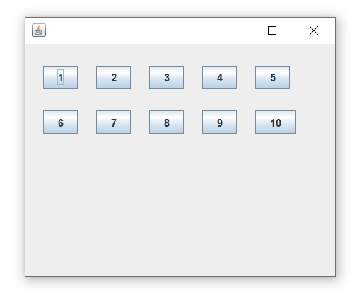
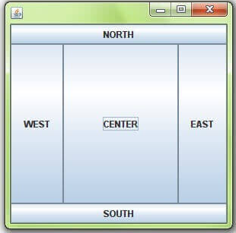
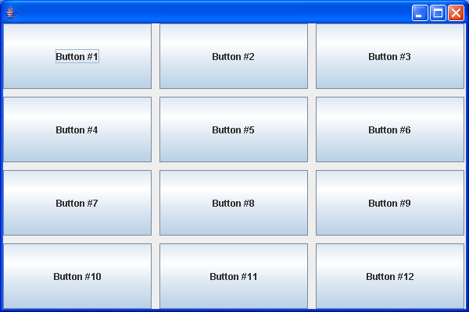
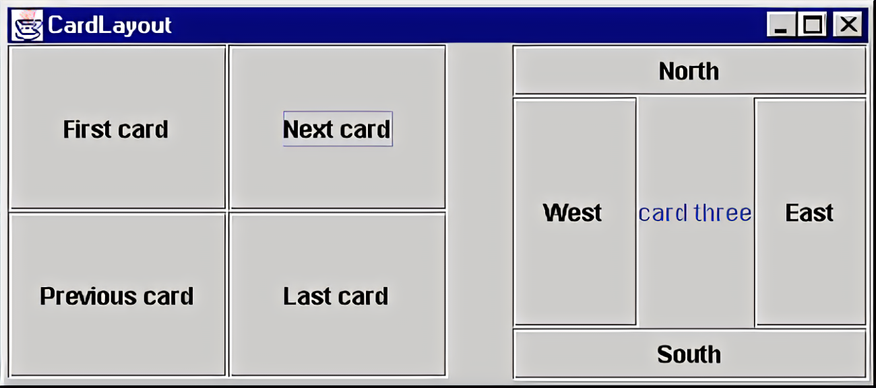
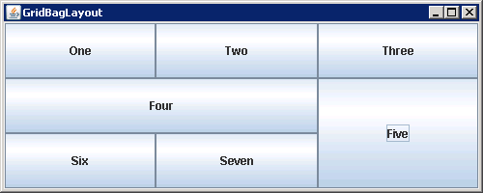
FlowLayout
BorderLayout
GridLyout
GridbangLayout
CardLayout

Slide 20
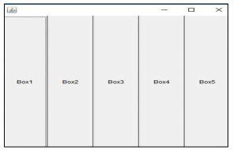
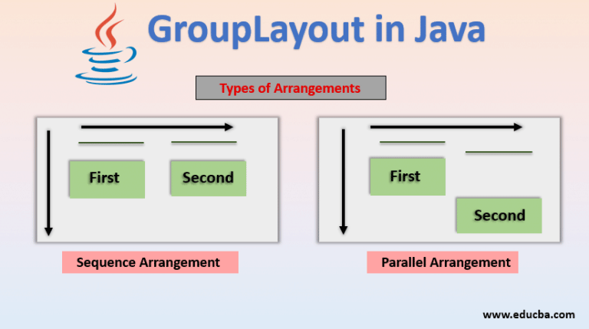
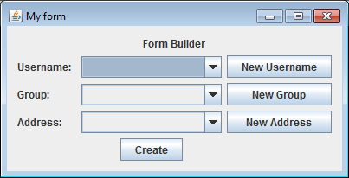
BoxLayout

Slide 21
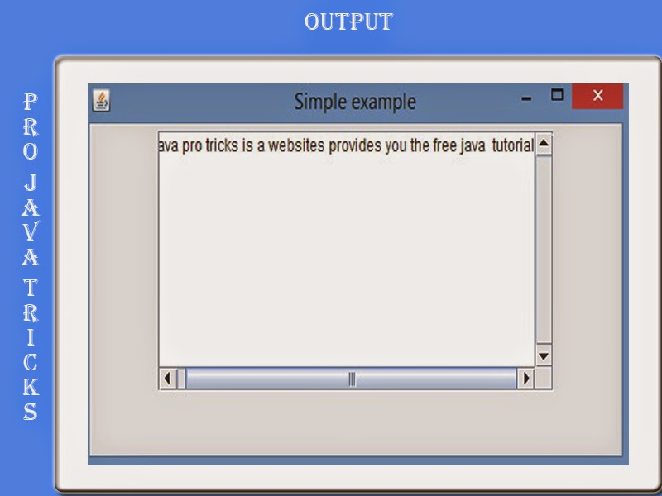
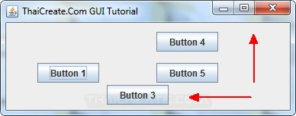
SpringLayout
ScrollPaneLayout
SpringLayout is a flexible layout manager designed for use by GUI builders. It lets you specify precise relationships between the edges of components under its control. For example, you might define that the left edge of one component is a certain distance (which can be dynamically calculated) from the right edge of a second component. SpringLayout lays out the children of its associated container according to a set of constraints, as shall be seen in How to Use SpringLayout.

Slide 22
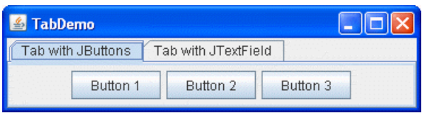
JPanel cards;
final static String BUTTONPANEL = "Card with JButtons";
final static String TEXTPANEL = "Card with JTextField"; //Where the components controlled by the CardLayout are initialized:
//Create the "cards".
JPanel card1 = new JPanel();
JPanel card2 = new JPanel();
//Create the panel that contains the "cards".
cards = new JPanel(new CardLayout());
cards.add(card1, BUTTONPANEL); cards.add(card2, TEXTPANEL);

Slide 23
import java.awt.*;
import javax.swing.*;
public class Border
{
JFrame f;
Border()
{
f = new JFrame();
// creating buttons
JButton b1 = new JButton("NORTH");; // the button will be labeled as NORTH
JButton b2 = new JButton("SOUTH");; // the button will be labeled as SOUTH
JButton b3 = new JButton("EAST");; // the button will be labeled as EAST
JButton b4 = new JButton("WEST");; // the button will be labeled as WEST
JButton b5 = new JButton("CENTER");; // the button will be labeled as CENTER
f.add(b1, BorderLayout.NORTH); // b1 will be placed in the North Direction
f.add(b2, BorderLayout.SOUTH); // b2 will be placed in the South Direction
f.add(b3, BorderLayout.EAST); // b2 will be placed in the East Direction
f.add(b4, BorderLayout.WEST); // b2 will be placed in the West Direction
f.add(b5, BorderLayout.CENTER); // b2 will be placed in the Center
f.setSize(300, 300);
f.setVisible(true); }
public static void main(String[] args) {
new Border(); }}

Slide 24
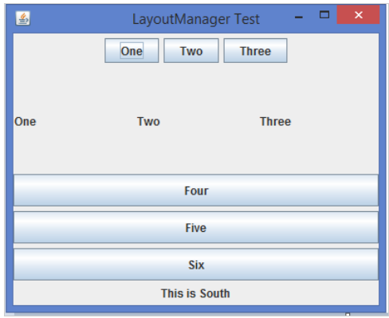

Slide 25
import java.awt.*;
import javax.swing.*;
public class LayoutManagerTest extends JFrame {
JPanel flowLayoutPanel1, flowLayoutPanel2, gridLayoutPanel1, gridLayoutPanel2, gridLayoutPanel3;
JButton one, two, three, four, five, six;
JLabel bottom, lbl1, lbl2, lbl3;
public LayoutManagerTest() {
setTitle("LayoutManager Test");
setLayout(new BorderLayout()); // Set BorderLayout for JFrame
flowLayoutPanel1 = new JPanel();
one = new JButton("One");
two = new JButton("Two");
three = new JButton("Three");
flowLayoutPanel1.setLayout(new FlowLayout(FlowLayout.CENTER)); // Set FlowLayout Manager
flowLayoutPanel1.add(one);
flowLayoutPanel1.add(two);
flowLayoutPanel1.add(three);
flowLayoutPanel2 = new JPanel();
bottom = new JLabel("This is South");

Slide 26
flowLayoutPanel2.setLayout (new FlowLayout(FlowLayout.CENTER)); // Set FlowLayout Manager
flowLayoutPanel2.add(bottom);
gridLayoutPanel1 = new JPanel();
gridLayoutPanel2 = new JPanel();
gridLayoutPanel3 = new JPanel();
lbl1 = new JLabel("One");
lbl2 = new JLabel("Two");
lbl3 = new JLabel("Three");
four = new JButton("Four");
five = new JButton("Five");
six = new JButton("Six");
gridLayoutPanel2.setLayout(new GridLayout(1, 3, 5, 5)); // Set GridLayout Manager
gridLayoutPanel2.add(lbl1);
gridLayoutPanel2.add(lbl2);
gridLayoutPanel2.add(lbl3);
gridLayoutPanel3.setLayout(new GridLayout(3, 1, 5, 5)); // Set GridLayout Manager
gridLayoutPanel3.add(four);
gridLayoutPanel3.add(five);
gridLayoutPanel3.add(six);

Slide 27
gridLayoutPanel1.setLayout(new GridLayout(2, 1)); // Set GridLayout Manager
gridLayoutPanel1.add(gridLayoutPanel2);
gridLayoutPanel1.add(gridLayoutPanel3);
add(flowLayoutPanel1, BorderLayout.NORTH);
add(flowLayoutPanel2, BorderLayout.SOUTH);
add(gridLayoutPanel1, BorderLayout.CENTER);
setSize(400, 325);
setDefaultCloseOperation(JFrame.EXIT_ON_CLOSE);
setLocationRelativeTo(null);
setVisible(true);
}
public static void main(String args[]) {
new LayoutManagerTest();
} }

Slide 28
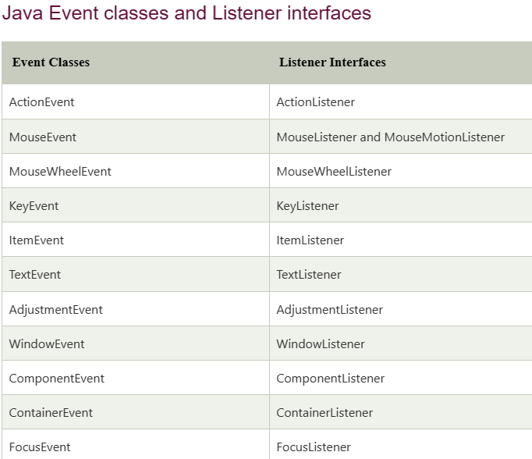
Event Handling
An event can be defined as changing the state of an object or behavior by performing actions.
For example, click on button, dragging mouse etc.
The java.awt.event package provides many event classes and Listener interfaces for event handling.

Slide 29
Delegation Event Model
In Delegation Event Model, a source generates an event and sends it to one or more listeners. Here, listener waits until it receives an event. Once the listener receives an event, it processes the event and then returns.
The advantage of this design is that the application logic that processes events is clearly separated from the user interface that generates those events.
In the delegation event model, listener must register with a source in order to receive an event notification.
The advantage of this is that the notifications are sent only to those listeners that want to receive them.
Previously, an event was propagated up the containment hierarchy until it was handled by a component.
This required components to receive events that they did not process, and it wasted valuable time. The delegation event model eliminates this overhead.

Slide 30
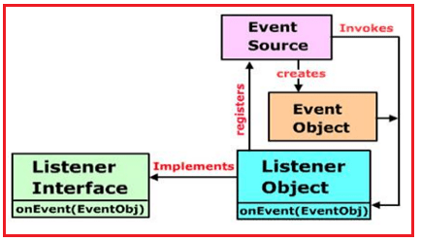
Delegation Event Model

Slide 31
Events:
In the delegation model, an event is an object that describes a state change in a source.
It can be generated as a consequence of a person interacting with the elements in a graphical user interface.
Some of the activities that cause events to be generated are pressing a button, entering a character via the keyboard, selecting an item in a list, and clicking the mouse.
Many other user operations could also be cited as examples.
Event Sources
A source is an object that generates an event. This occurs when the internal state of that object changes in some way. Sources may generate more than one type of event. A source must register listeners in order for the listeners to receive notifications about a specific type of event. Each type of event has its own registration method.
public void addTypeListener(TypeListener el) throws java.util.TooManyListenersException
Here, Type is the name of the event, and el is a reference to the event listener.

Slide 32
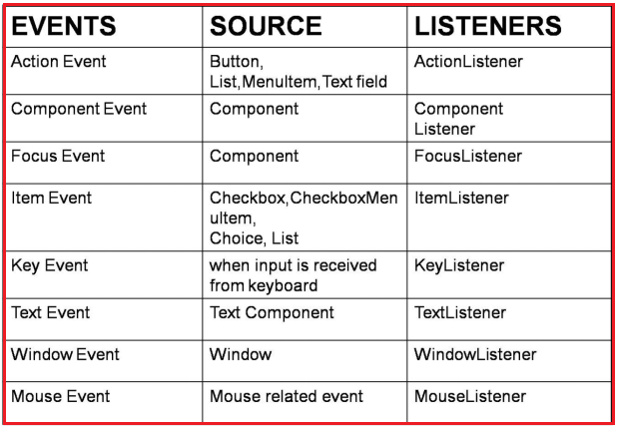
Event Listeners
A listener is an object that is notified when an event occurs.
It has two major requirements.
First, it must have been registered with one or more sources to receive notifications about specific types of events.
Second, it must implement methods to receive and process these notifications.
The methods that receive and process events are defined in a set of interfaces found in java.awt.event

Slide 33
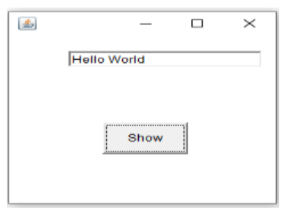
import java.awt.*;
import java.awt.event.*;
class EventHandling extends Frame implements ActionListener
{
TextField textField;
EventHandling ()
{
textField = new TextField ();
textField.setBounds (60, 50, 170, 20);
Button button = new Button ("Show");
button.setBounds (90, 140, 75, 40);
button.addActionListener (this);
add (button);
add (textField);
setSize (250, 250);
setLayout (null);
setVisible (true);
}
public void actionPerformed (ActionEvent e)
{
textField.setText ("Hello World");
}
public static void main (String args[])
{
new EventHandling ();
}
}

Slide 34
Event Classes
The root of the Java event class hierarchy is EventObject, which is in java.util
AWTEvent is a superclass of all AWT events that are handled by the delegation event model
The ActionEvent Class
An ActionEvent is generated when a button is pressed, a list item is double-clicked, or a menu item is selected. The ActionEvent class defines four integer constants that can be used to identify any modifiers associated with an action event: ALT_MASK, CTRL_MASK, META_MASK, and SHIFT_MASK. In addition, there is an integer constant, ACTION_ PERFORMED, which can be used to identify action events.

Slide 35
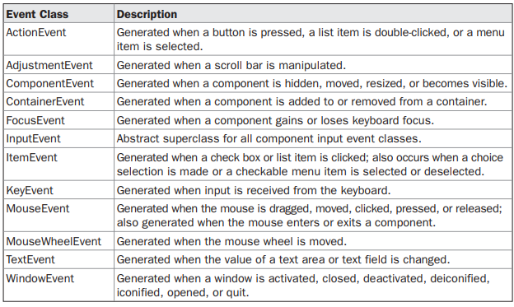

Slide 36
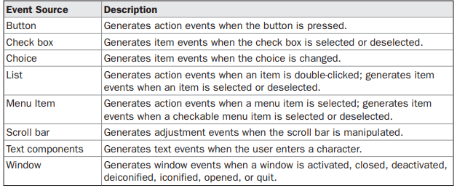
Sources of Events

Slide 37
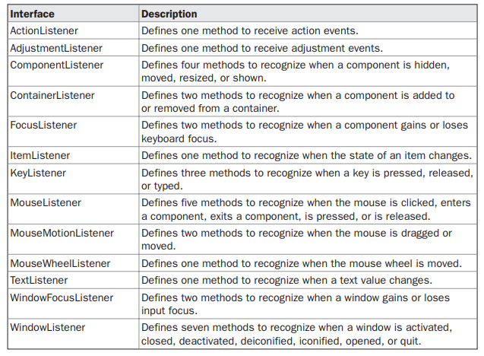
Event Listener Interfaces

Slide 38
Item event : DESELECTED and SELECTED
Textbevent : TEXT_VALUE_CHANGED.
Focus event : FOCUS_GAINED and FOCUS_LOST
Container event : COMPONENT_ADDED and COMPONENT_REMOVED.
Key events: KEY_PRESSED, KEY_RELEASED, and KEY_TYPED
Mouse events: MOUSE_CLICKED, MOUSE_DRAGGED, MOUSE_ENTERED, MOUSE_EXITED, MOUSE_MOVED, MOUSE_PRESSED, MOUSE_RELEASED and MOUSE_WHEEL.
MouseWheelEvent:: WHEEL_BLOCK_SCROLL and WHEEL_UNIT_SCROLL.
Window event: WINDOW_ACTIVATED, WINDOW_CLOSED, WINDOW_CLOSING, WINDOW_DEACTIVATED, WINDOW_DEICONIFIED, WINDOW_GAINED_FOCUS, WINDOW_ICONIFIED, WINDOW_LOST_FOCUS, WINDOW_OPENED, and WINDOW_STATE_CHANGED.

Slide 39
Handling Mouse Events
To handle mouse events, you must implement the MouseListener and the MouseMotionListener interfaces
import java.awt.*;
import java.awt.event.*;
public class MouseListenerExample extends Frame implements MouseListener{
Label l;
MouseListenerExample(){
addMouseListener(this);
l=new Label();
l.setBounds(20,50,100,20);
add(l);
setSize(300,300);
setLayout(null);
setVisible(true);
}
public void mouseClicked(MouseEvent e) {
l.setText("Mouse Clicked");
}
public void mouseEntered(MouseEvent e) {
l.setText("Mouse Entered");
}
public void mouseExited(MouseEvent e) {
l.setText("Mouse Exited");
}
public void mousePressed(MouseEvent e) {
l.setText("Mouse Pressed");
}
public void mouseReleased(MouseEvent e) {
l.setText("Mouse Released");
}
public static void main(String[] args) {
new MouseListenerExample();
}
}

Slide 40
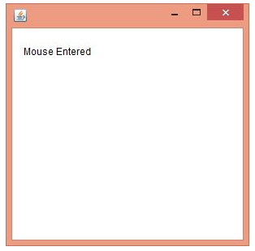

Slide 41
Handling Keyboard Events
import java.awt.Container;
import java.awt.Graphics; import java.awt.Point;
import java.awt.event.KeyEvent;
import java.awt.event.KeyListener;
import java.awt.event.WindowAdapter;
import java.awt.event.WindowEvent;
import javax.swing.JFrame;
import javax.swing.JPanel;
public class SketchPanel extends JPanel implements KeyListener {
private Point startPoint = new Point(0, 0);
private Point endPoint = new Point(0, 0);
public SketchPanel() {
addKeyListener(this); }
public void keyPressed(KeyEvent evt) {
int keyCode = evt.getKeyCode();
int d;
if (evt.isShiftDown())
d = 5;
else d = 1;
if (keyCode == KeyEvent.VK_LEFT)
add(-d, 0);
else if (keyCode == KeyEvent.VK_RIGHT) add(d, 0);
else if (keyCode == KeyEvent.VK_UP)
add(0, -d);
else if (keyCode == KeyEvent.VK_DOWN)
add(0, d); }

Slide 42
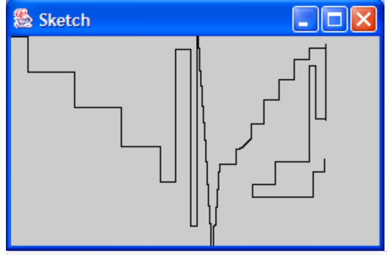
public void keyReleased(KeyEvent evt) { }
public void keyTyped(KeyEvent evt) { }
public boolean isFocusTraversable() {
return true; }
public void add(int dx, int dy) {
endPoint.x += dx;
endPoint.y += dy;
Graphics g = getGraphics();
g.drawLine(startPoint.x, startPoint.y, endPoint.x, endPoint.y);
g.dispose();
startPoint.x = endPoint.x;
startPoint.y = endPoint.y;
}
public static void main(String[] args) {
JFrame frame = new JFrame();
frame.setTitle("Sketch");
frame.setSize(300, 200);
frame.addWindowListener(new WindowAdapter() {
public void windowClosing(WindowEvent e) {
System.exit(0); } });
Container contentPane = frame.getContentPane();
contentPane.add(new SketchPanel()); frame.show(); } }

Slide 43
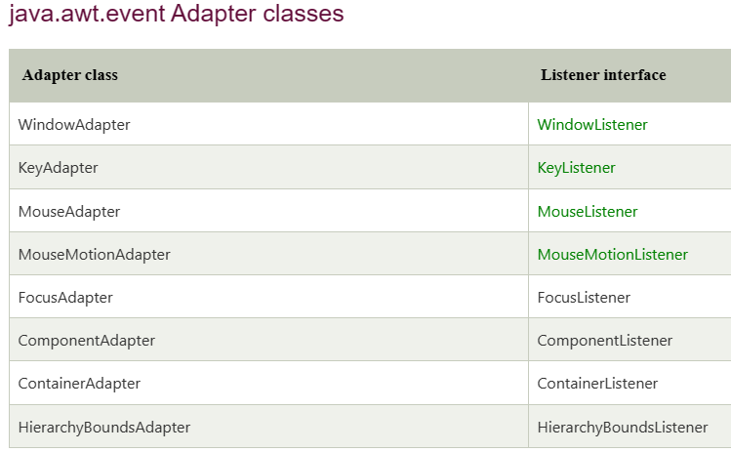
Java Adapter Classes
Java adapter classes provide the default implementation of listener interfaces. If you inherit the adapter class, you will not be forced to provide the implementation of all the methods of listener interfaces. So it saves code.

Slide 44
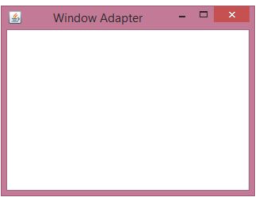
import java.awt.*;
import java.awt.event.*;
public class AdapterExample {
// object of Frame
Frame f;
// class constructor
AdapterExample() {
// creating a frame with the title
f = new Frame ("Window Adapter");
// adding the WindowListener to the frame
// overriding the windowClosing() method
f.addWindowListener (new WindowAdapter() {
public void windowClosing (WindowEvent e) {
f.dispose();
}
});
// setting the size, layout and
f.setSize (400, 400);
f.setLayout (null);
f.setVisible (true);
}
// main method
public static void main(String[] args) {
new AdapterExample(); } }

Slide 45
Java Inner Classes
In Java, it is also possible to nest classes (a class within a class).
The purpose of nested classes is to group classes that belong together, which makes your code more readable and maintainable.
To access the inner class, create an object of the outer class, and then create an object of the inner class:

Slide 46
class OuterClass
{ int x = 10;
class InnerClass
{
int y = 5;
}
}
public class Main {
public static void main(String[] args) { OuterClass myOuter = new OuterClass(); OuterClass.InnerClass myInner = myOuter.new InnerClass();
System.out.println(myInner.y + myOuter.x); }
}

Slide 47
Java Anonymous inner class
In simple words, a class that has no name is known as an anonymous inner class in Java. It should be used if you have to override a method of class or interface.
Java Anonymous inner class can be created in two ways:
Class (may be abstract or concrete).
Interface
abstract class Person{
abstract void eat();
}
class TestAnonymousInner{
public static void main(String args[]){
Person p=new Person()
{
void eat(){System.out.println("nice fruits");}
};
p.eat();
}
}
A class is created, but its name is decided by the compiler, which extends the Person class and provides the implementation of the eat() method.

Slide 48
Internal class generated by the compiler
import java.io.PrintStream;
static class TestAnonymousInner$1 extends Person
{
TestAnonymousInner$1(){}
void eat()
{
System.out.println("nice fruits");
}
}

Slide 49
Java anonymous inner class example using interface
interface Eatable{
void eat();
}
class TestAnnonymousInner1{
public static void main(String args[]){
Eatable e=new Eatable(){
public void eat(){System.out.println("nice fruits");}
};
e.eat();
}
}

Slide 50
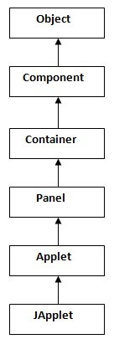
Applets
Applet is a special type of program that is embedded in the webpage to generate the dynamic content.
It runs inside the browser and works at client side
There are many advantages of applet. They are as follows:
It works at client side so less response time.
Secured
It can be executed by browsers running under many plateforms,
including Linux, Windows, Mac Os etc.

